Slide 1
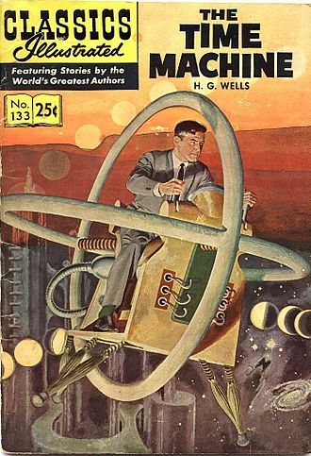
The Time Machine Vocabulary
Expounding
Recondite
Intermittent
Incredulous
Poignant
Precocious
Impetus
Imperceptible
Abomination
Calamity

