Slide 1
Something Wicked This Way Comes
Ray Bradbury and Science Fiction Introduction

Slide 2
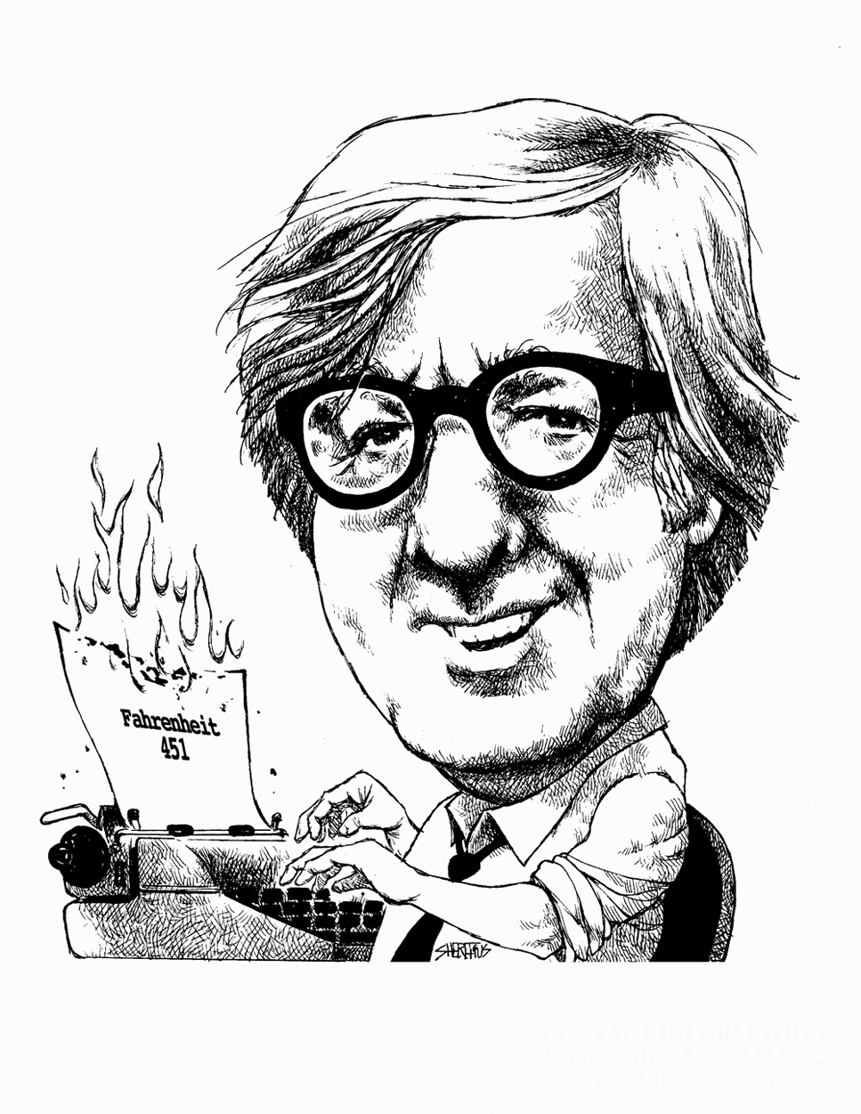
Ray Bradbury
Born in Waukegan, IL
Made $15 for his 1st published short story
Best known for:
The Martian Chronicles
The Illustrated Man
Fahrenheit 451
Picture Source

Slide 3
Science Fiction
“Anything you dream is fiction and anything you accomplish is science. The whole history of mankind is nothing but science fiction.”
~ Ray Bradbury
Blends fact and fiction with futuristic technology
Often explores the question, “What if?”
Investigates moral, philosophical and technological possibilities by creating new and exciting realities

Slide 4
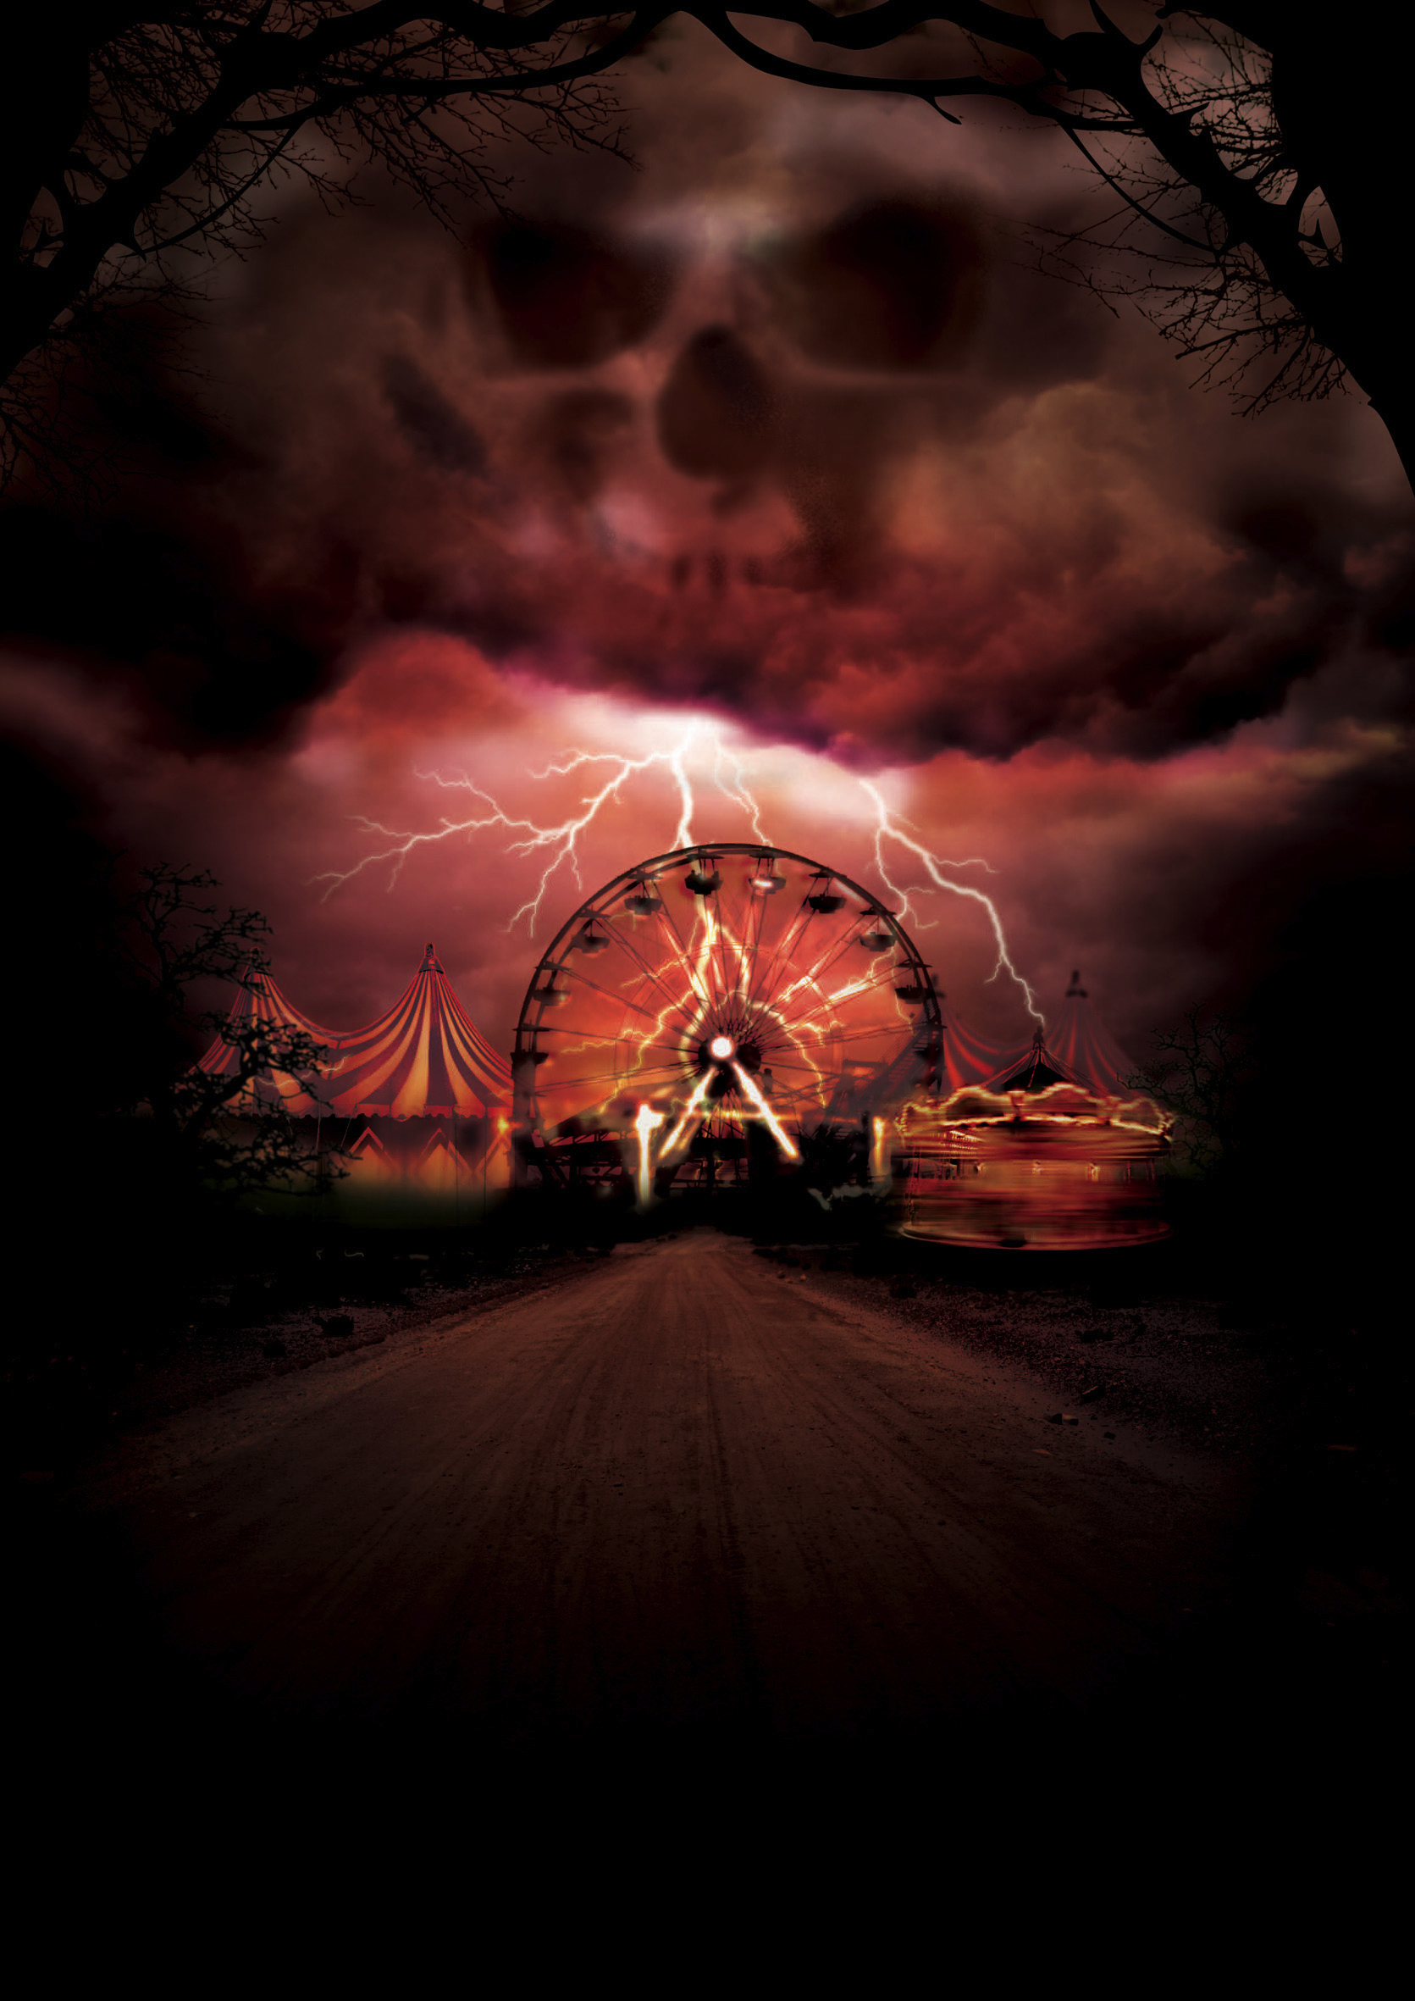
Something Wicked This Way Comes
Expanded from a 10-page short story
Published in 1962
Setting: Late October in small town Illinois
Uses foreshadowing throughout much of the novel
Picture Source

Slide 5
Inspiration
In 1932, a carnival entertainer called Mr. Electrico touched Ray Bradbury with an electrified sword. Ray’s hair stood on end as Mr. Electrico shouted, “Live forever!”
Picture Source

Slide 6
SWTWC Vocabulary
List 1
List 2
Rummage
Contraption
Incongruous
Sibilant
Exhilaration
Calliope
Gesticulation
Fathom
Rictus
Tumult
Akimbo
Berserk
Juggernaut
Grille
Alchemy
Cuneiform
Cloister
Pander
Croupier
Whorl

Slide 7
Judging a Book by its Cover
On the next slide there are 8 different covers for Something Wicked This Way Comes
Attempt to analyze the covers in order to produce a 1 paragraph guess at what the novel will be about.
When complete, turn it in and grab a book
Be sure to tell Gathman your book number
You will have the rest of the block to work on your vocabulary or start reading SWTWC

Slide 8
