Slide 1
Slaughterhouse-Five
Day 4 – Chapter 5

Slide 2
Journal 4
“The guard shoved him back into ranks. ‘Vy you? Vy anybody?’ he said” (Vonnegut 91).

Slide 3
The Tralfamadorian Novel
“What we love in our books are the depths of many marvelous moments seen all at one time” (88).
Some of us are struggling with how this book jumps from place to place along the timeline.
  How does the Tralfamadorian novel differ?
Which do you prefer, the storyline or the story?

Slide 4
Poo-tee-weet?
“They hadn’t seen any birds, either. Not even sparrows would come into the camp” (93).
How is this different than earlier in the book when we first see the comment poo-tee-weet?
  Why won’t even birds visit the camps?

Slide 5
Eliot Rosewater and Kilgore Trout
Recurring characters in Vonnegut’s novels
“[T]hey were trying to re-invent themselves and their universe. Science fiction was a big help” (101).
What were they trying to re-invent and why?
How could this have helped them?
Are Billy’s memories/the Tralfamadorians real?
  Do they need to be?

Slide 6
Guest Character: Kurt Vonnegut
“An American near Billy wailed that he had excreted everything but his brains. Moments later he said, ‘There they go, there they go.’ He meant his brains. That was I. That was me. That was the author of this book” (125).

Slide 7
Journal 5 – Howard W Campbell, Jr.
Protagonist of Mother Night (another Vonnegut novel)
American playwright that married a German and worked for the Nazi propaganda department during WWII
  He was also an American spy, or was he?
“America is the wealthiest nation on Earth, but its people are mainly poor, and poor Americans are urged to hate themselves” (128).

Slide 8
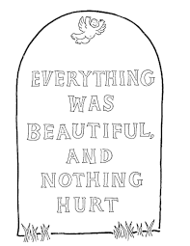
So it goes.
“A crazy thought now occurred to Billy. The truth of it startled him. It would make a good epitaph for Billy Pilgrim—and for me, too” (121).
Epitaph – a commemorative inscription on a tomb about the person buried there
Your job – create a tombstone and epitaph for one of the many to have died thus far in the novel
  Include a page number, duh.

Slide 9
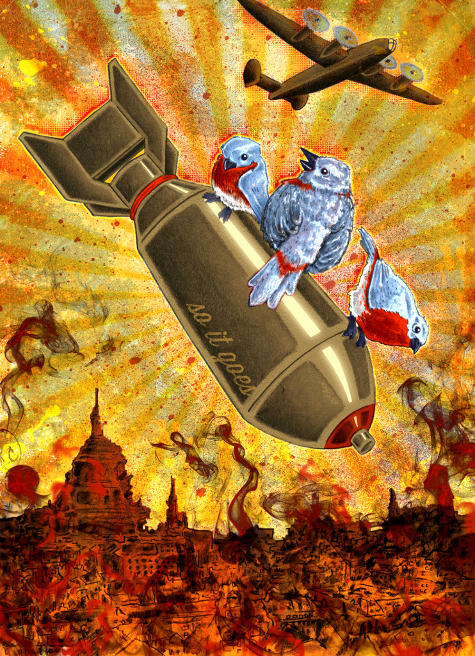
Homework
Read Chapters 6-7
Vocabulary 2

