Slide 1
Poetry
Day 2
Reading, Analyzing, & Poetic Language

Slide 2
Reading and Analyzing Poetry
Reading
Analyzing
Read it Again
Each time you read a poem it will bring you either more understanding or more questions. Both can be helpful.
Read it Aloud
Sometimes you just need to hear how the words sound.
Don’t Skim
Poets (unlike other writers) have limited space. Therefore almost every word in a poem is significant.
Be Patient
Poetry is difficult at times. Don’t give up on yourself.
Become an Archaeologist
Dig until you have found what may have been lost over time.
Special meanings, symbolism, imagery, rhythm, rhyme, etc.
Think Like a Poet
Cover the next line and see if what comes is expected or if the poet has made an unexpected turn
Write it Out
Take notes on the poem, ask questions, draw arrows to link words or ideas
Never be Intimidated
Poetry is about freedom and exposing yourself to new things. In fact, if you find yourself stuck in a poem, just remember that the poet, 9 times out of 10, was a bit of a rebel and was trying to make his friends look at life in a completely different way.

Slide 3
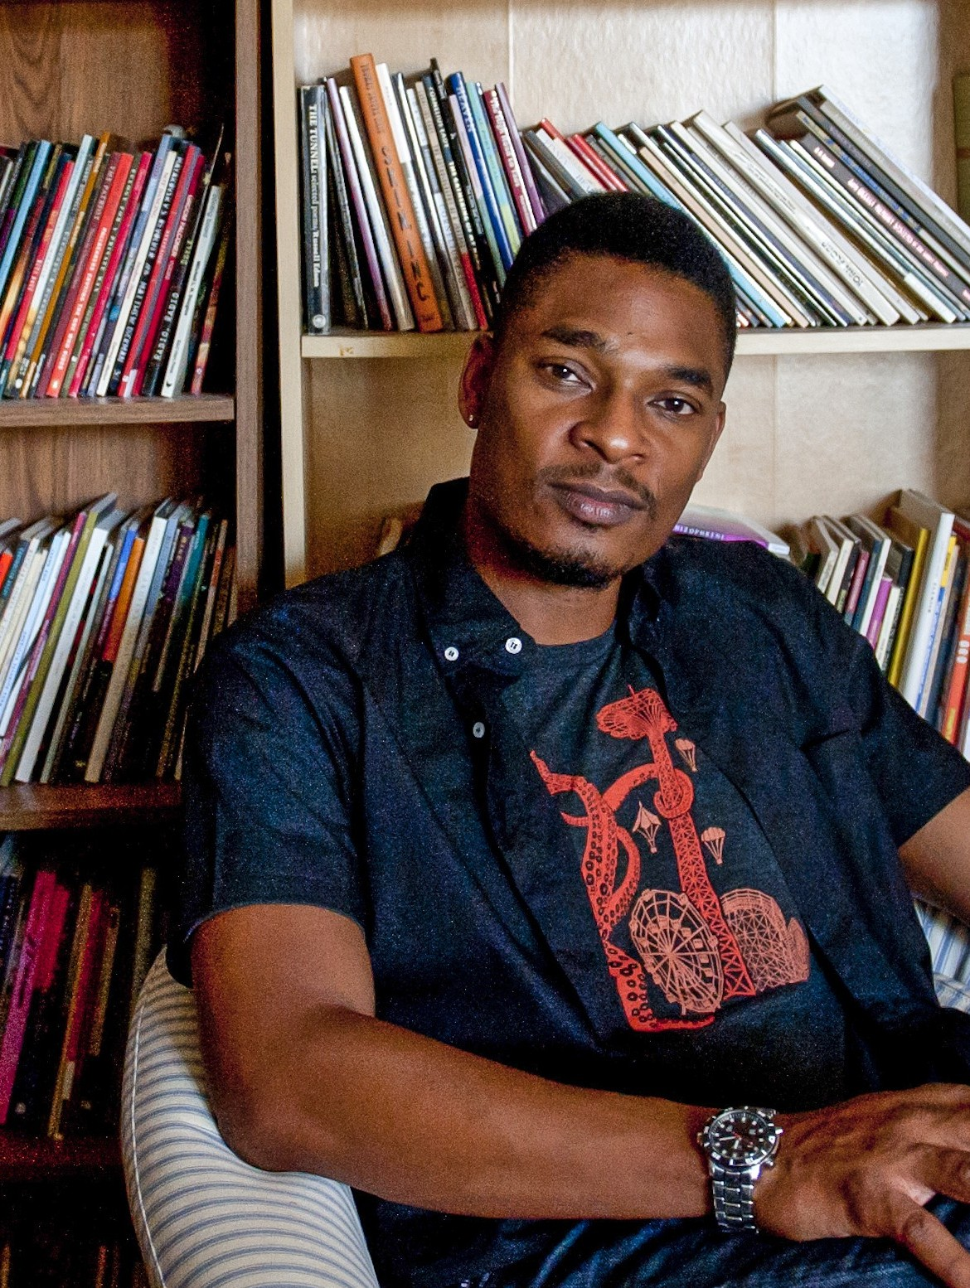
Terrance Hayes
Poet Focus

Slide 4
Say What You Want To Say
Denotation
Connotation
The literal dictionary definition of a word
The emotional/imaginative definition(s) of a word
Your pod will draw 2 words. You will then need to create a poster showing both the denotation and the connotation of the words drawn. You will share your words and poster with the class.

Slide 5
Words without Meaning
Certain words in the English language have been overused and now have no certain meaning and/or have been labeled as cliché.
The use of such words can ruin a great poem.
These words should be used sparingly.

Slide 6
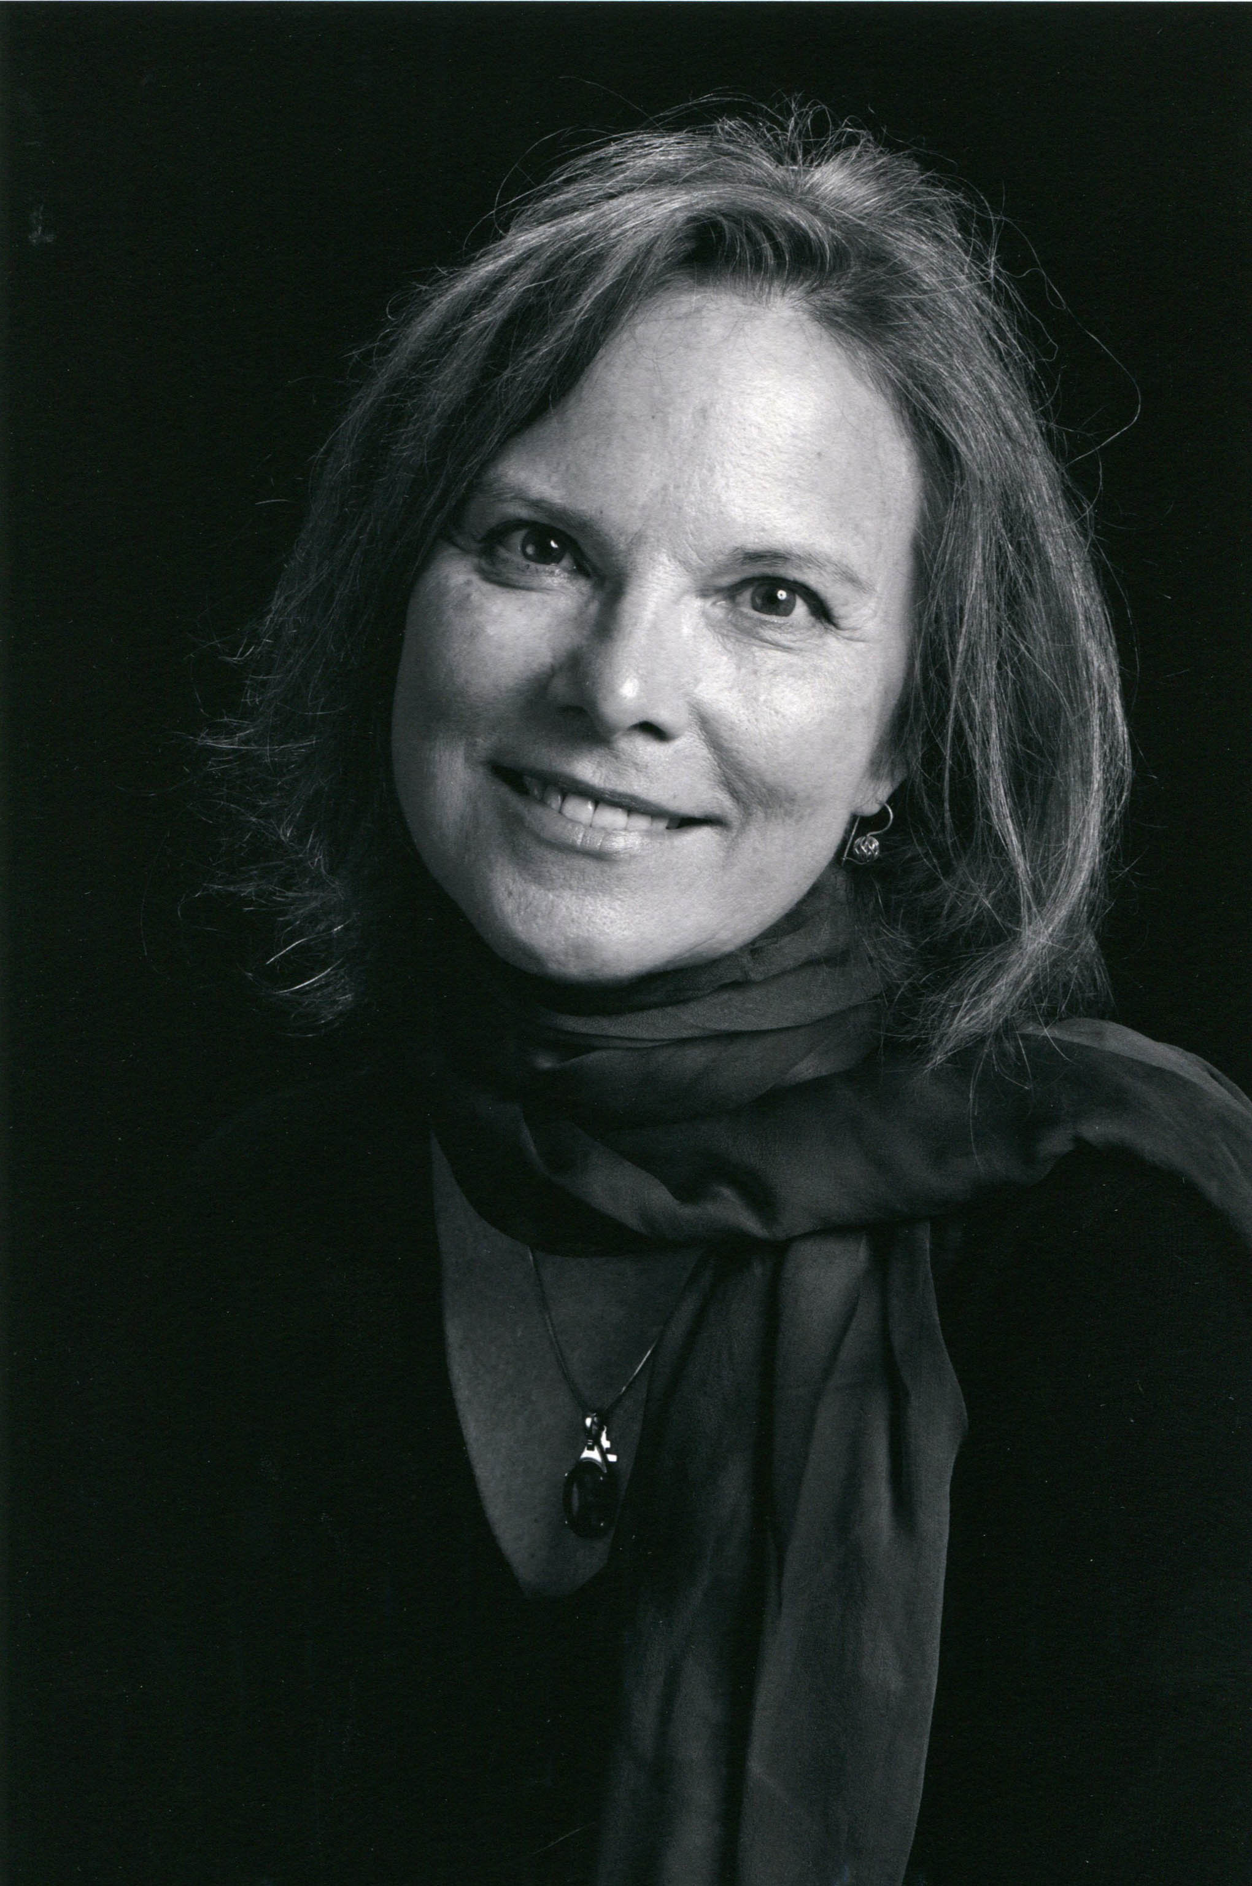
Carolyn Forché
Poet Focus

Slide 7
Snake | Terminal | Lawyer | House | Home
Nerd | Jock | Rat | Chicken | Freedom
Student | Teacher | Nosy | Strange | Normal
Love | Hate | Depression | Old | Young

