Slide 1
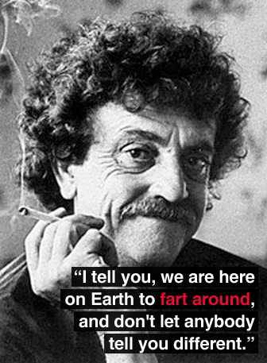
Vonnegut Bio
He was born and died.
So it goes.
Grew up in Indianapolis.
Fought in World War II.
Taught at the University of Iowa.
And he wrote.

Slide 2
Humanism
An outlook or system of thought attaching prime importance to human rather than divine or supernatural matters.
Humanist beliefs stress the potential value and goodness of human beings, emphasize common human needs, and seek solely rational ways of solving human problems.
Vonnegut was the honorary president of the American Humanist Association and his views one humanity are apparent throughout all of his works.

Slide 3
Vonnegut’s Style
Satire
Black Humor
The use of humor, irony, exaggeration, or ridicule to expose and criticize people's stupidity or vices, particularly in the context of contemporary politics and other topical issues.
A comic work that employs farce and morbid humor, which, in its simplest form, is humor that makes light of subject matter usually considered taboo.
Black comedy is often controversial due to its subject matter.

Slide 4
He’s not just a Science Fiction writer.
Science Fiction is just that: science + fiction
It could be medicine or technology, but it utilizes something that doesn’t exist at the time written.
At the time, science fiction was looked down upon by other writers and critics.
Vonnegut defended the genre, and deplored a perceived sentiment that "no one can simultaneously be a respectable writer and understand how a refrigerator works.”

Slide 5
Player Piano
Vonnegut’s Knowledge
The Book
After serving in World War II, Vonnegut spent time working for General Electric giving him the first hand knowledge of machinery, engineering, and technical vocabulary used throughout the novel.
Vonnegut’s first novel
Published in 1952
Setting: a near-future society that is almost totally mechanized, eliminating the need for human laborers.
Themes include:
Automation of Industry
Technology
Mankind’s Purpose
Self Worth
Faith

Slide 6
Foreward
and… what?
What can we expect from the novel after reading the Foreward?
What do you think you will see in the pages that follow?

Slide 7
Player Piano Vocabulary
List 1
Lists 2 AND 3
Patois
Solicit
Vicarious
Euphoria
Ennui
Echelon
Asymmetrical
Patina
Skitter
Opaque
Deprecating
Bureaucrat
12 words per list
You pick them from anywhere in the book
List page numbers next to the words

