Slide 1
Of Mice and Men
Day 2 – Chapters 1 & 2

Slide 2
Think – Ink – Pod – Share
You will see a topic/quote with some questions.
Take a minute to think it over.
Write out your thoughts.
Talk it out with your pod.
Share your ideas with the class.

Slide 3
Lennie’s Pets
“‘What you want of a dead mouse, anyways?’ ‘I could pet it with my thumb while we walked along,’ said Lennie” (Steinbeck 6).
What does this tell the reader about Lennie?
Would Lennie mean to do any creature (man or beast) harm?

Slide 4
Together
“We got a future. We got somebody to talk to that gives a damn about us” (14).
Do Lennie and George appear to be friends?
How is friendship different than companionship?
How important is it for Lennie to have George? or vice versa?

Slide 5
The Farm
“O.K. Someday—we’re gonna get the jack together and we’re gonna have a little house and a couple of acres an’ a cow and some pigs and–” (14).
What is the purpose of the farm for George and Lennie?
Do you believe they actually see it as possible?

Slide 6
The Wild West
“Up the hill from the river a coyote yammered, and a dog answered from the other side of the stream” (16).
Why do you think Steinbeck gives us this image of both wild and domesticated life?
Can we relate this to our characters and their lifestyles?

Slide 7
Curley
“Well he better watch out for Lennie. Lennie ain’t no fighter, but Lennie’s strong and quick and Lennie don’t know no rules” (27).
What does this quote mean by rules?
What do you think this might foreshadow?

Slide 8
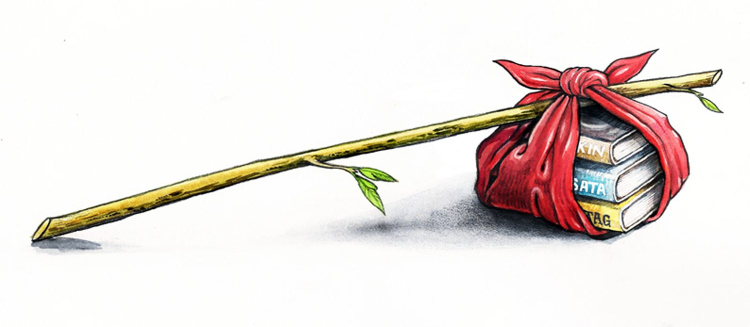
The Bindlestiff Portal
Oddly enough, you have been transported to the 1930s and the only work you can find is that of a migrant farm worker.
You have too much to carry and can only keep what can fit in your bindle and on your back
Rank the belongings from most important (1) to least important (25)
Remember, this is the 1930s…
Then star (*) the ones that you would actually be able to fit in your bindle and on your back comfortably.
Write a 2 paragraph summary of why you chose what you did & how life would be different if this was all you had.

Slide 9
Pictures of family/friends | Keys to your car | Can opener | 2 candy bars | Portable music player
Sacred religious book | Bathing suit | Gaming console | Warm blanket | Canteen
Journal | Laptop | Favorite book | 6 cans of beans (w/ketchup) | Extra outfit
Cast-iron pan | Pain medication | Pillow | Microwave popcorn | Matches
Driver’s license | Cell phone | Pen | Hand lotion | Hat
Pictures of family/friends | Keys to your car | Can opener | 2 candy bars | Portable music player
Sacred religious book | Bathing suit | Gaming console | Warm blanket | Canteen
Journal | Laptop | Favorite book | 6 cans of beans (w/ketchup) | Extra outfit
Cast-iron pan | Pain medication | Pillow | Microwave popcorn | Matches
Driver’s license | Cell phone | Pen | Hand lotion | Hat

