Slide 1
Night
Pages 29-65

Slide 2
Turn in Vocabulary 1 – Label It!
Vocabulary List 2
Untenable
Dissipate
Benediction
Kaddish
Knell
Automaton
Dignity
Interminable
Indifference
Insidious

Slide 3
Night Journal 3
Write candidly for 5 minutes regarding the following prompt(s). Be honest with your thoughts. What does it mean? How do the words affect you?
“How was it possible that men, women, and children were being burned and that the world kept silent?” (32).

Slide 4
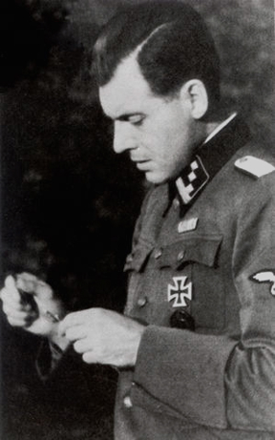
Dr. Mengele
German officer and physician
In charge of selection
Known for experimenting on Jewish prisoners
Experiments were unscientific and often deadly
Avoided capture and fled to South America – lived without prosecution dying in 1979

Slide 5
The Needs of Resistance
Within your group try to come up with as large of a list of things necessary to resist and fight back against a regime like that of the Nazis.
These do not have to be tangible items, they can be thoughts, ideals, viewpoints as well.

Slide 6
Deterrents
Now, create a separate list of factors that would stop people from wanting to resist.
These do not have to be tangible items, they can be thoughts, ideals, viewpoints as well.

Slide 7
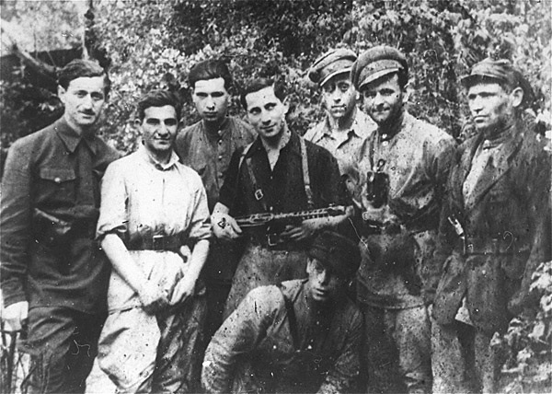
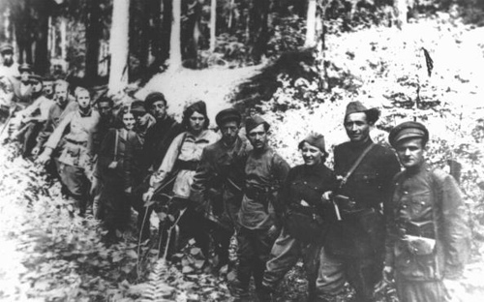
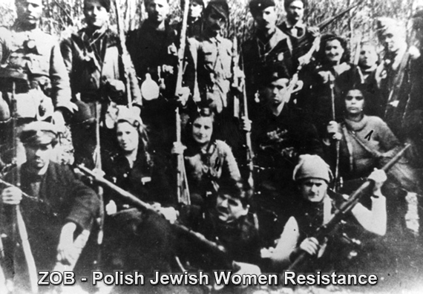
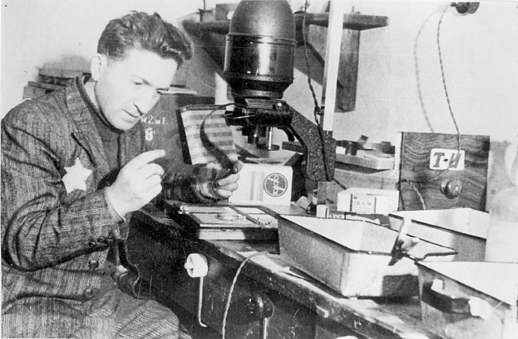
Faces of Resistance

Slide 8
Think – Ink – Pod – Share
You will see a quote
Write a response in your notebook
Anything that you want that relates to the quote: our previous readings, discussions, or video
Discuss what you wrote with your pod
Share as a class

Slide 9
Understanding
“The beloved objects that we had carried with us from place to place were now left behind in the wagon and with them, finally, our illusions” (29).

Slide 10
The Mourner’s Prayer
“Someone began to recite Kaddish, the prayer for the dead. I don’t know whether, during the history of the Jewish people, men have ever before recited Kaddish for themselves” (33).

Slide 11
Wiesel’s Faith
“I had ceased to pray. I concurred with Job! I was not denying His existence, but I doubted His absolute justice” (45).

Slide 12
Patience
“Bite your lips, little brother…Don’t cry. Keep your anger, your hate, for another day, for later. The day will come but not now…Wait. Clench your teeth and wait” (53).

Slide 13
Bombing Buna
“We were not afraid…we no longer feared death, in any event not this particular death. Every bomb that hit filled us with joy, gave us renewed confidence” (60).

Slide 14
The Norm
“[T]hree gallows, three ravens…machine guns aimed at us: the usual ritual” (64).

Slide 15
Homework
Read pages 66-84 for next class
Vocabulary List 2 due in two blocks

