Slide 1
Mother Night
Kurt Vonnegut

Slide 2
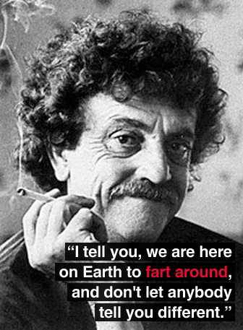
Kurt Vonnegut. Remember him?
He was born and died.
So it goes.
Grew up in Indianapolis.
Fought in World War II.
Taught at the University of Iowa.
And he wrote.
We read Player Piano last year.

Slide 3
Humanism
An outlook or system of thought attaching prime importance to human rather than divine or supernatural matters.
Humanist beliefs stress the potential value and goodness of human beings, emphasize common human needs, and seek solely rational ways of solving human problems.

Slide 4
Vonnegut’s Style
Satire
Black Humor
The use of humor, irony, exaggeration, or ridicule to expose and criticize people's stupidity or vices, particularly in the context of contemporary politics and other topical issues.
A comic work that employs farce and morbid humor, which, in its simplest form, is humor that makes light of subject matter usually considered taboo.
Black comedy is often controversial due to its subject matter.

Slide 5
Mother Night
Published 1961
Fictional memoirs of Howard W. Campbell Jr.
Writing while awaiting trial for war crimes
Tells the story of his life, not simply why he is on trial

Slide 6
Themes
Identity
Betrayal
Fate
Religion
War
Love
Pride
Patriotism

Slide 7
Mother Night Vocabulary
List 1
List 2
Fanatical
Invective
Morbid
Apparatus
Contempt
Copious
Sovereign
Carrion
Recluse
Dossier
Guise
Bereft
Menial
Repatriate
Consternation
Epitaph
Monolithic
Lapel
Totalitarian
Haggard
Galvanize
Eulogy
Loom
Lavish

Slide 8
The Introduction
Three Morals
Vonnegut’s Heritage
“We are what we pretend to be, so we must be careful about what we pretend to be” (Vonnegut v).
“When you’re dead you’re dead” (viii).
Yeah, we aren’t really going to talk about this one.
“If I’d been born in Germany, I suppose I would have been a Nazi” (vii).

Slide 9
Editor’s Note: The Title
Quote on xii
Mephistopheles is sure that the dark came before the light and hopes that soon he can help the dark return
Often this is related to how too much ambition can lead to disastrous ends
Pay attention to that idea, it relates heavily to the Nazis and their uses of propaganda

Slide 10
Journal Expectations
Journals will be collected at the end of the unit.
You get 5 minutes to write about the given quote or topic.
All journals must be complete to get a grade.
Quality thoughts and productive writing will get you a 4.

Slide 11
Journal 1 - Lies
“To say that he was a writer is to say that the demands of art alone were enough to make him lie, and to lie without seeing any harm in it…for no one is a better liar than a man who has warped lives and passions onto something as grotesquely artificial as stage” (ix).
What does this make you think about our main character knowing what we do before the book even begins? (memoirs, trial for war crimes, etc.)

