Slide 1
The Illustrated Man
by Ray Bradbury

Slide 2
Ray Bradbury
August 22, 1920 –
June 5, 2012
American fantasy, science fiction, horror and mystery writer
Barack Obama once said that Ray Bradbury had "reshaped our culture and expanded our world".
Other Famous Works:
The Martian Chronicles
Something Wicked This Way Comes
Fahrenheit 451

Slide 3
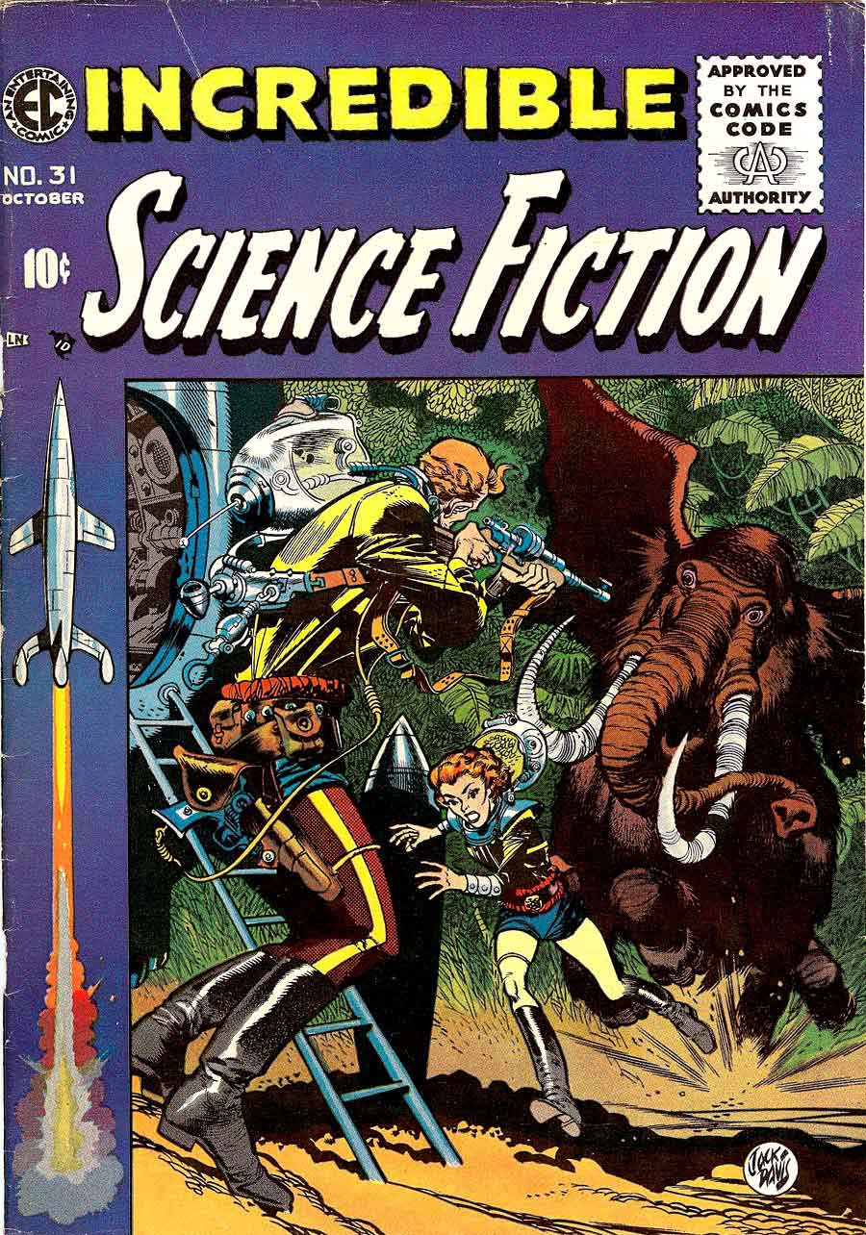
Science Fiction
Writing that tells about imaginary events that involve (often advanced) science or technology
Often set in the future
Locations Vary:
Earth
Other planets
Total imaginary place

Slide 4
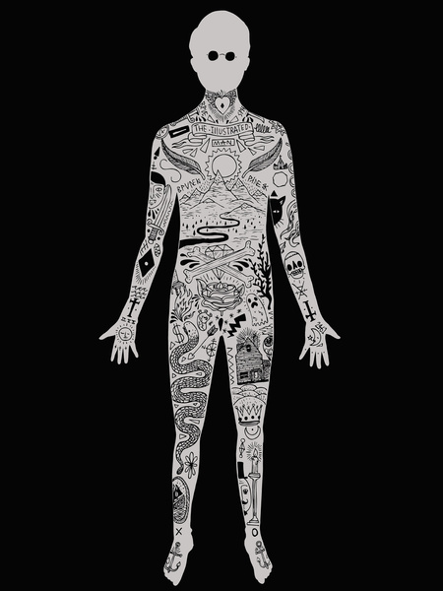
The Illustrated Man
Collection of 18 short stories published in 1951
Unrelated stories with similar themes
Psychology of people and the detached nature of technology

Slide 5
Common Themes
Abuse of Technology
Faith
Religion
Death
Sanity
Revenge
War
Power
Knowledge
Fear

Slide 6
“Prologue”

Slide 7
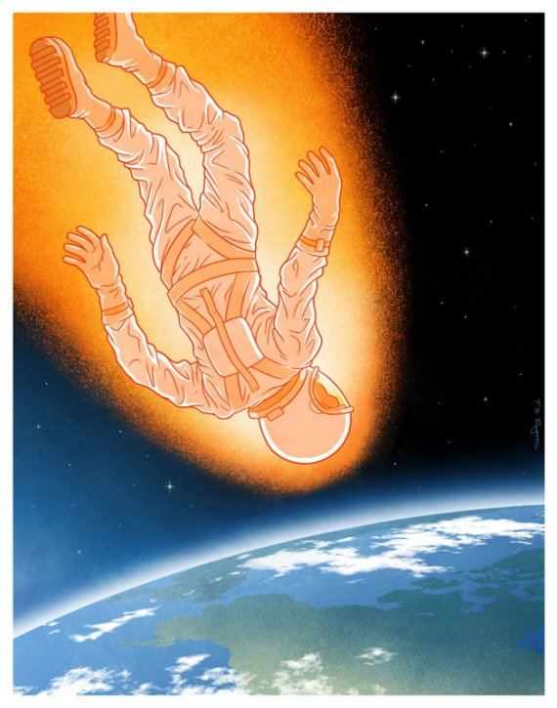
The Illustrated Man Vocabulary
Oblivious
Hypocrisy
Perpetual
Ember
Exile
Derelict
Sterile
Turret
Concoction

