Slide 1
Fahrenheit 451
The Sieve and the Sand

Slide 2
Turn in Vocabulary 2

Slide 3
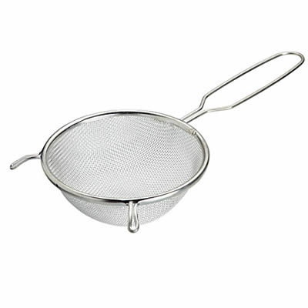
The Sieve and the Sand
Sieve /siv/
a utensil consisting of a wire or plastic mesh held in a frame, used for straining solids from liquids, for separating coarser from finer particles, or for reducing soft solids to a pulp

Slide 4
The Sieve and the Sand
Directions: Prepare an oral presentation for a symbol/theme
You will need one quote, two-three examples from the book, and a reason why this relates to us now.
Group 1: Fire
Group 2: Sand and Sieve
Group 3: Snakes
Group 4: Color White
Group 5: Color Black

Slide 5
“How in hell did those bombers get up there every second of our lives! Why doesn’t someone want to talk about it!” (75).

Slide 6
“‘I don’t talk things, sir,’ said Faber. ‘I talk the meaning of things. I sit here and know I’m alive’” (77).

Slide 7
“There is nothing magical in them at all. The magic is only in what books say, how they stitched the patches of the universe together into one garment for us” (85).

Slide 8
“The books are to remind us what asses and fools we are” (88).

Slide 9
“If you hide your ignorance, no one will hit you and you’ll never learn” (106).

Slide 10
“What traitors books can be!” (110).

Slide 11
Making Inferences about Character Development The Sieve and the Sand (Part 2)
Event | Effect on Montag | Detail(s) from Novel
Montag recalls first meeting with Prof. Faber
Montag recalls sieve and sand
Montag goes to Prof. Faber’s house
Montag reads “Dover Beach” to Millie and friends
Montag returns to work
The fire truck arrives at Montag’s house

