Slide 1
Anthem
Now we work.

Slide 2
Journal
What is your favorite type of cheese and why? What do you like to put cheese on? Is cheese your favorite dairy product, or do you prefer milk?
Courtesy of Alyse Manley
You have 10 minutes, create!

Slide 3
Gaea and Prometheus
Grab the information sheet off of the class website so we can discuss the names chosen by Ayn Rand for the novel’s protagonists.

Slide 4
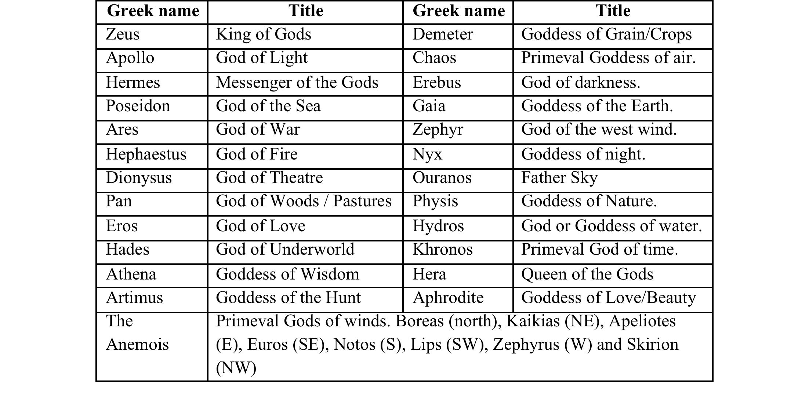
Your Turn
Pick the name of the god/goddess that you think best describes you.
Draw yourself as that God.
We will be posting the English gods around the classroom, so be sure to depict yourself as awesomely as possible.

Slide 5
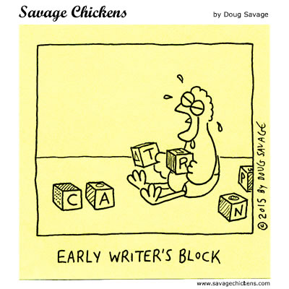
Let’s talk essays.

